Slide 1
CAPT Stone Software Development
By: William Lin

Slide 2

What is Software Development?
Software development is the act of creating and maintaining software or computer programs. But what are software's and computer programs? It is everything and anything that is on your computer or electronic device that is intangible. Some examples include, Microsoft Office, Google Chrome, and all Websites. For example iOS is a software. It was created by many developers (that’s what we call them), and they are constantly fixing and changing it which is also software development.

Slide 3
Before
Before I even started this project I did not know much if not nothing about computer programming. I never questioned how a computer worked.
As a freshman in Pre-Algebra, I was taught how to program a function into a calculator. Then in geometry I was taught once again to program a calculator. I was told in geometry that programming was essentially how all technology worked.
As a junior I took my first programming course. This was where I learned to program my first program:
public static void main(String[] args){
System.out.println(“Hello World!”);
}

Slide 4
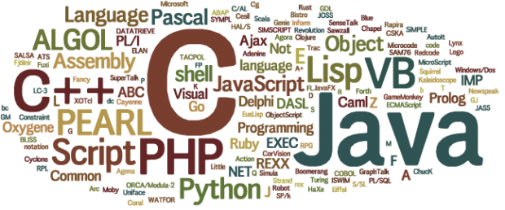

Why I Chose CS
CS stands for computer science and software developing fails in the CS category.
I chose computer science because there are so many possibilities on what you can do. When it comes to creating something new, there are millions of things you could create. How you create it is up to you.
I like to think developers are like artists. Developers and artist both work on their own ideas and do their own work. In the end they both create a masterpiece that can be sold for money, maybe even a lot of money. Only difference is a computer in place of a canvas.

Slide 5
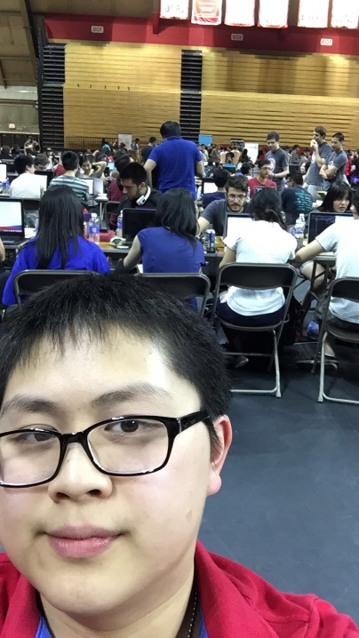
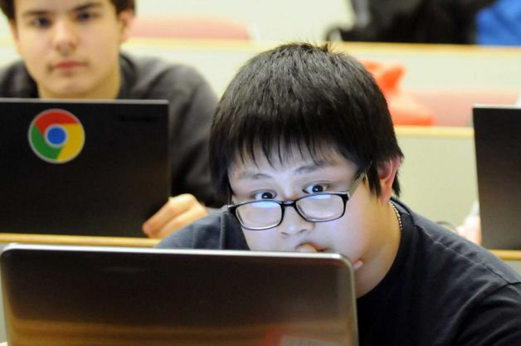
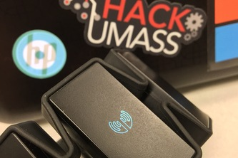
What I Did
I learned more about software developing.
I created projects that utilized software and also hardware.
I went to multiple Hackathons. HackRPI, Hackathonukah, Tuft’s MedStart, HackSpotify, HackUMass, HackRU.

Slide 6
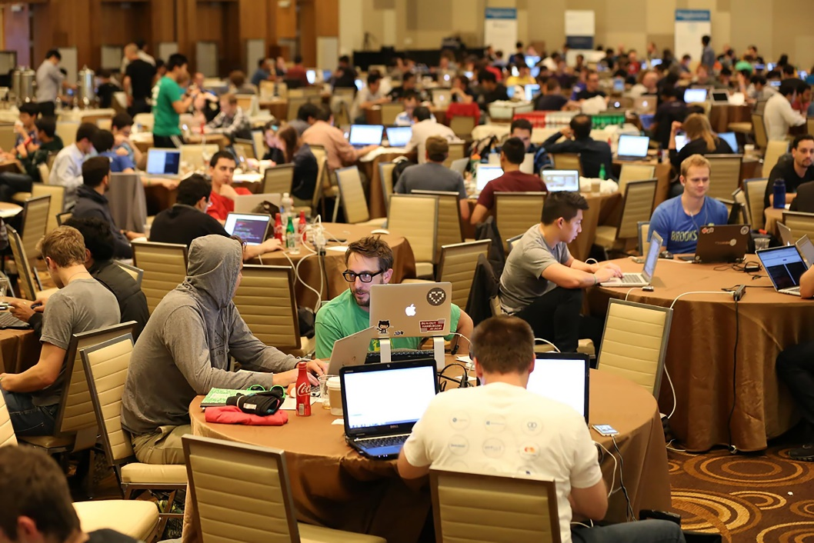
Hackathons
Hackathons are not events that you “hack” at. They are events where developers and engineers from all different places come together to work on a project together. It can be a place where you build something just for fun. Or you can compete with everyone else and their teams in a competition.

Slide 7
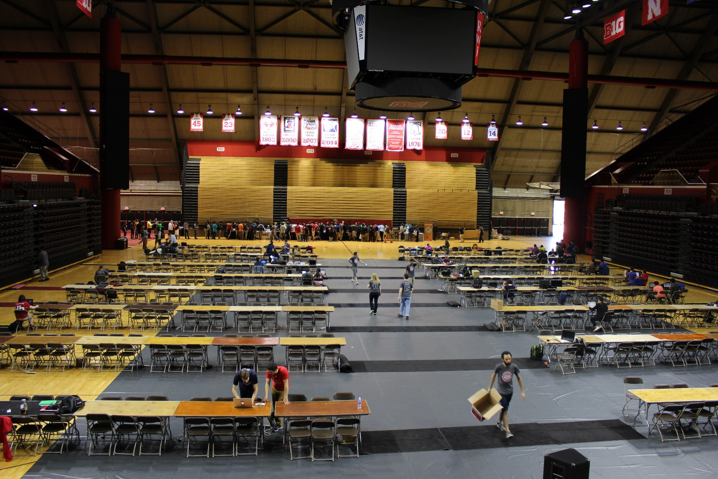
HackRU Before

Slide 8
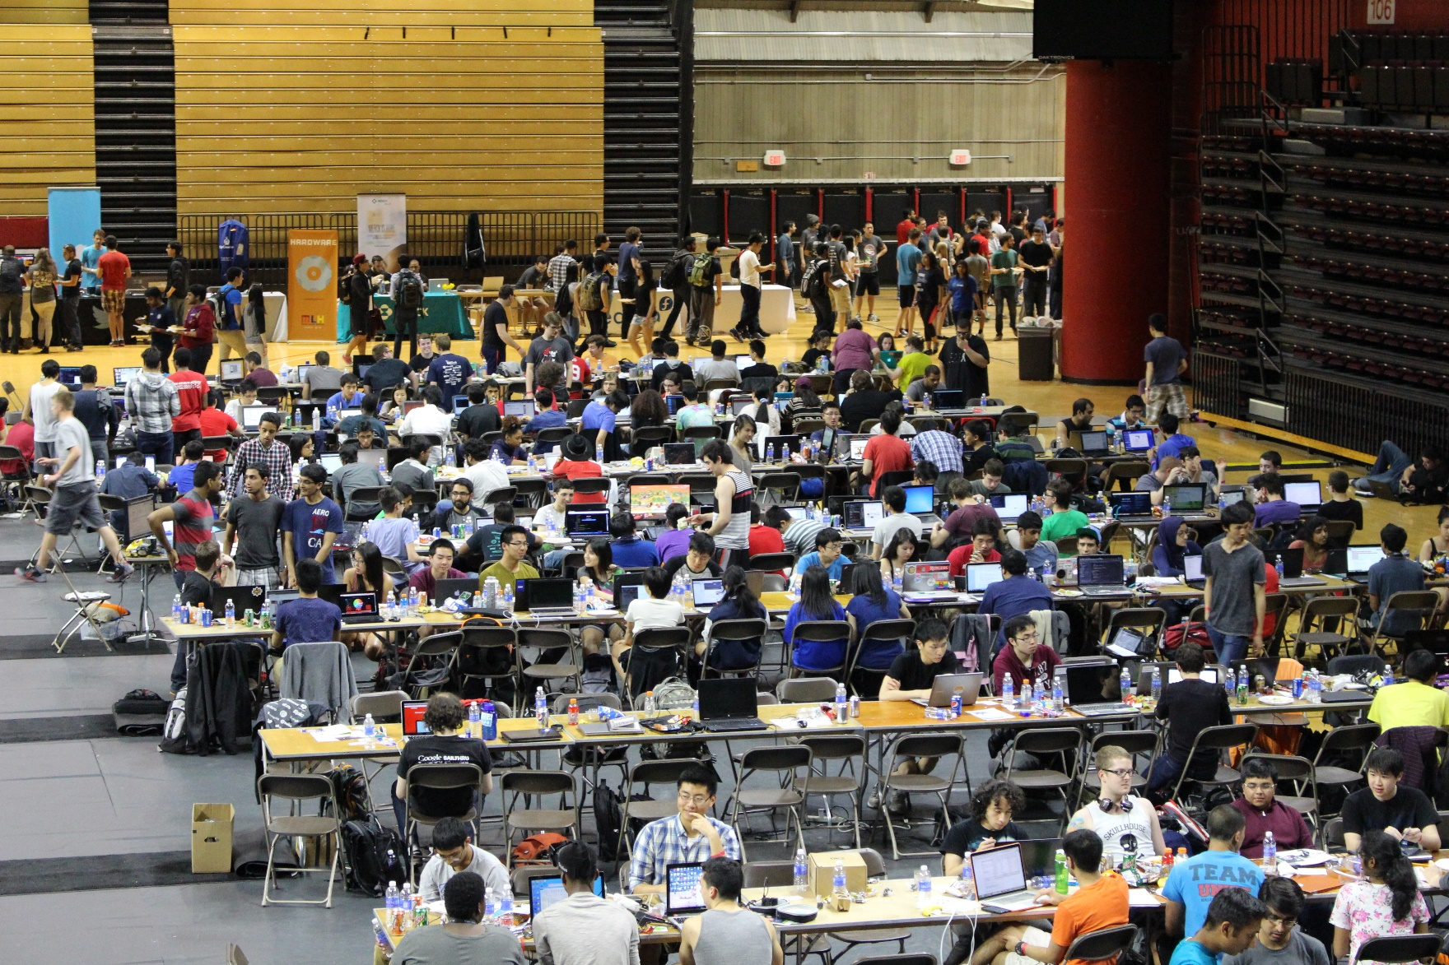
HackRU After

Slide 9
Some Challenges
The hardest challenges in computer programming and software development, are bugs. Bugs are errors in your code that can cause everything to not work. They can be easy to find and easy to find. But some are hard to find and even harder to fix. I have encountered many bugs along the way.
Learning how to use a certain development tool or hardware is challenging. Sometimes the resources you are given can be a challenge. When I try to learn how to use a new tool I can get confused and lost. It’s like learning a new instrument, maybe a little bit easier.

Slide 10
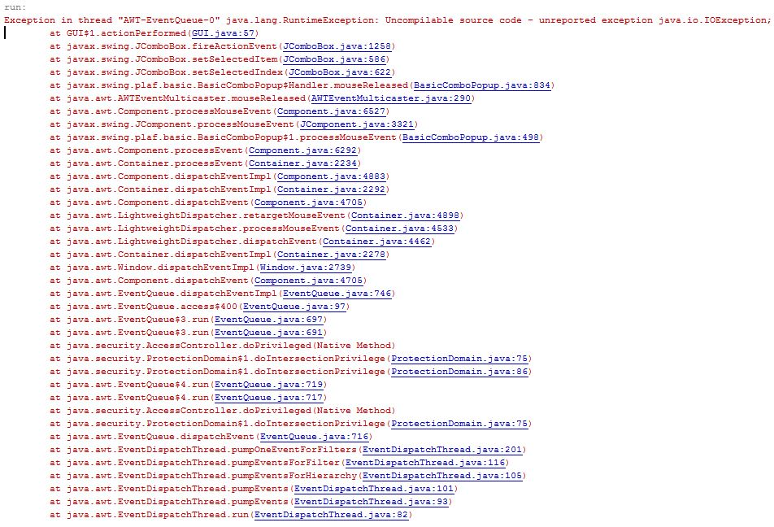
An Error

Slide 11
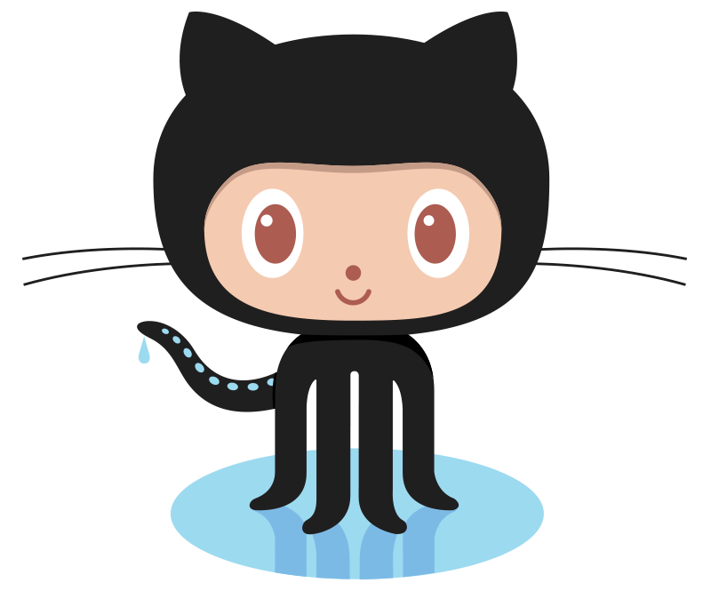
In The End
At the end of this project I was able to learn a ton of new stuff. I was able to meet new people and learn new things.
I definitely still want to be a software developer.
I still love software developing, maybe even more after this project.
I learned about Hackathons and I plan to attend as many as I can because they’re a great way to learn and get more experience.
I think this project has helped me push myself to create and develop new things that I never knew how to develop.
My GitHub handle: https://github.com/FanciestW

